Slide 1
Learning Objective
I will be able to solve applications of trigonometric functions
Success Criteria
At the end of the lesson, I will be able to:
Apply knowledge of trigonometric functions to solve word problems

Slide 2
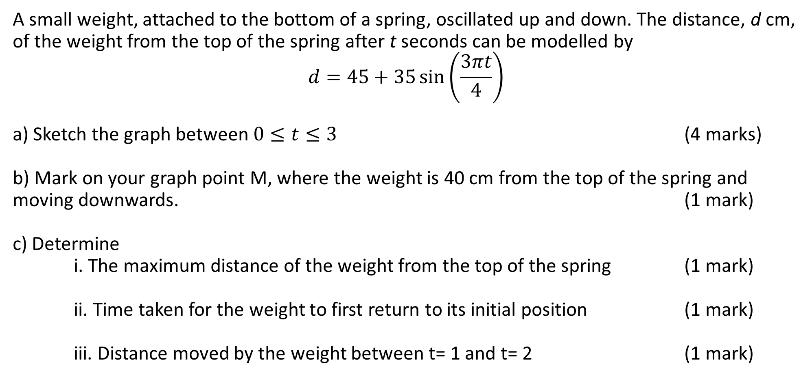
2019 CALC ASSUMED
A small weight, attached to the bottom of a spring, oscillated up and down. The distance, d cm, of the weight from the top of the spring after t seconds can be modelled by
$$d=45+35\sin\left(\frac{3πt}{4}\right)$$
a) Sketch the graph between $0≤t≤3$ (4 marks)
b) Mark on your graph point M, where the weight is 40 cm from the top of the spring and moving downwards. (1 mark)
c) Determine i. The maximum distance of the weight from the top of the spring (1 mark)
ii. Time taken for the weight to first return to its initial position (1 mark)
iii. Distance moved by the weight between t= 1 and t= 2 (1 mark)

Slide 3
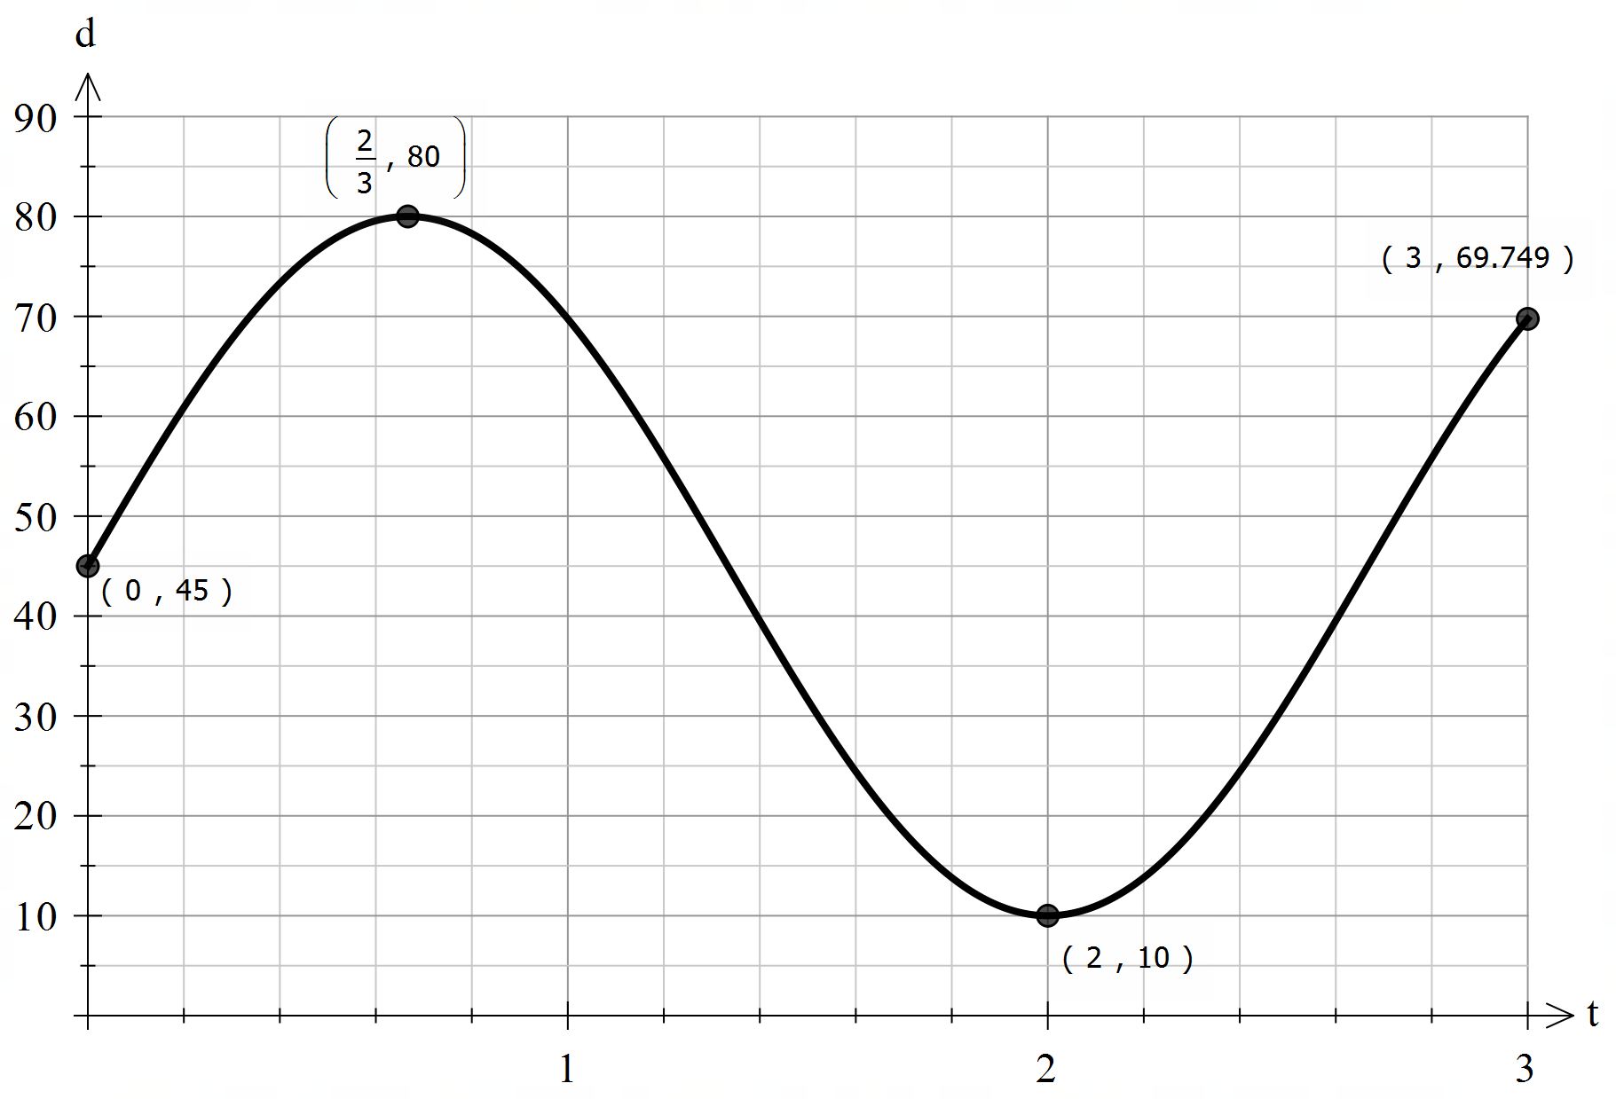
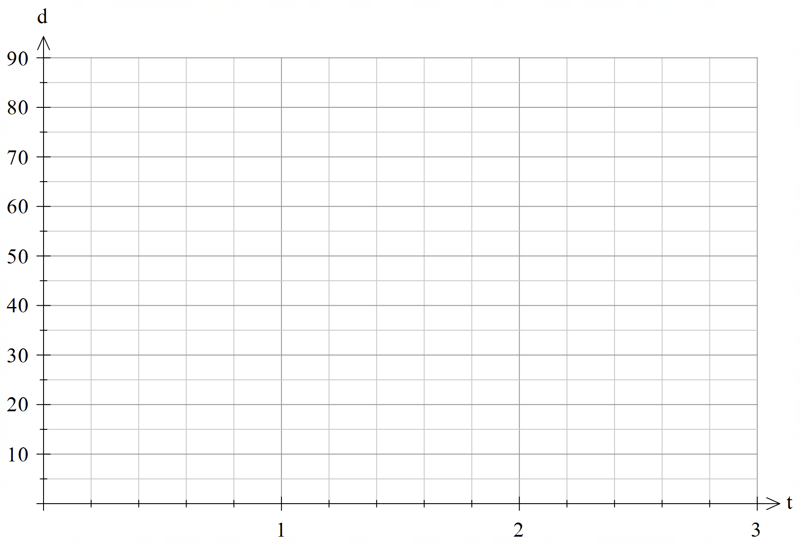
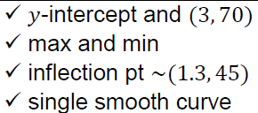


2019 CALC ASSUMED
A small weight, attached to the bottom of a spring, oscillated up and down. The distance, d cm, of the weight from the top of the spring after t seconds can be modelled by
$$d=45+35\sin\left(\frac{3πt}{4}\right)$$
a) Sketch the graph between $0≤t≤3$ (4 marks)
b) Mark on your graph point M, where the weight is 40 cm from the top of the spring and moving downwards. (1 mark)

Slide 4
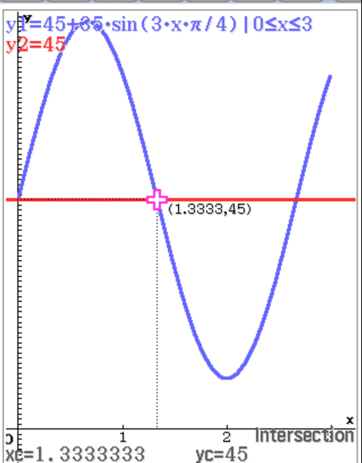
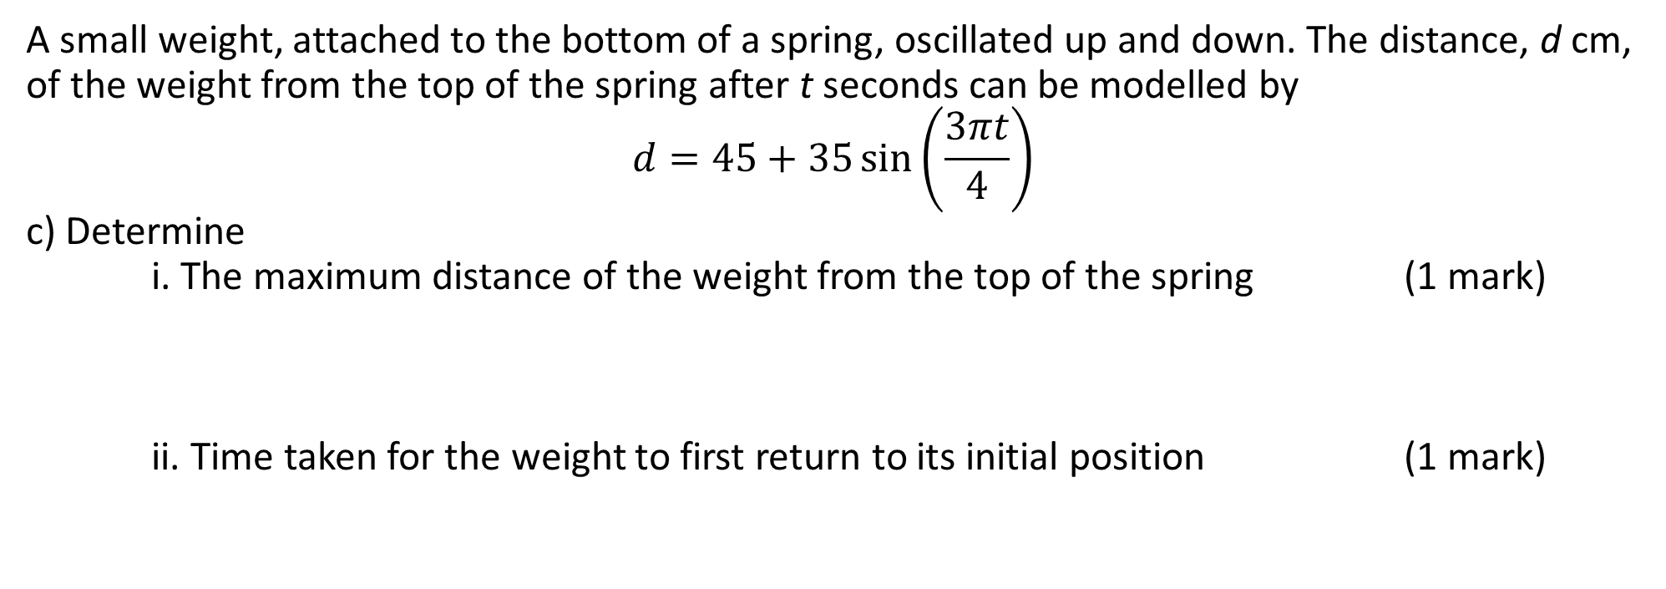
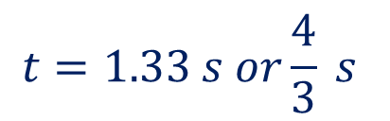

2019 CALC ASSUMED
A small weight, attached to the bottom of a spring, oscillated up and down. The distance, d cm, of the weight from the top of the spring after t seconds can be modelled by
$$d=45+35\sin\left(\frac{3πt}{4}\right)$$
c) Determine i. The maximum distance of the weight from the top of the spring (1 mark)
ii. Time taken for the weight to first return to its initial position (1 mark)
$$d\left(max\right)=80 cm$$
$$t=1.33 s or\frac{4}{3} s$$

Slide 5
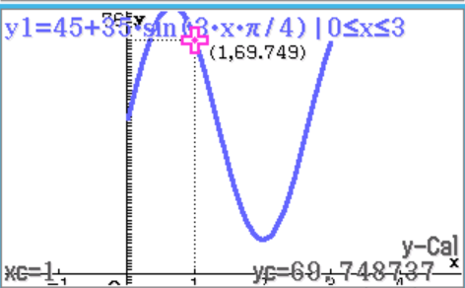
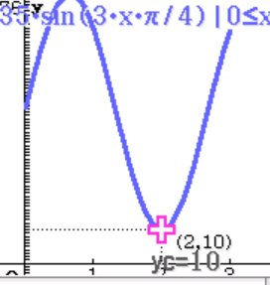
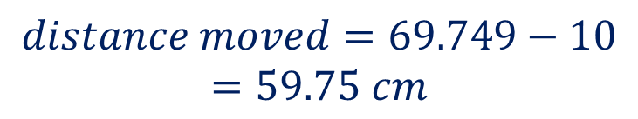
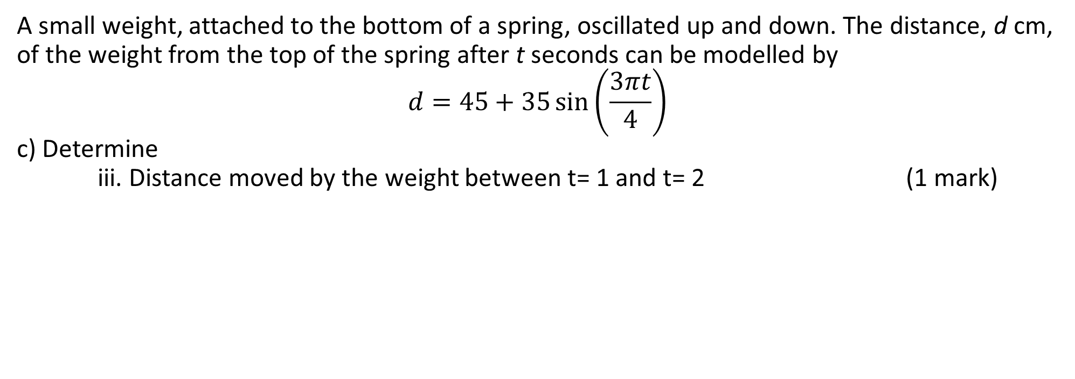


2019 CALC ASSUMED
A small weight, attached to the bottom of a spring, oscillated up and down. The distance, d cm, of the weight from the top of the spring after t seconds can be modelled by
$$d=45+35\sin\left(\frac{3πt}{4}\right)$$
c) Determine
iii. Distance moved by the weight between t= 1 and t= 2 (1 mark)
$$d\left(1\right)=69.749 cm$$
$$d\left(2\right)=10 cm$$
$$distance moved=69.749−10$$
$$=59.75 cm$$

Slide 6
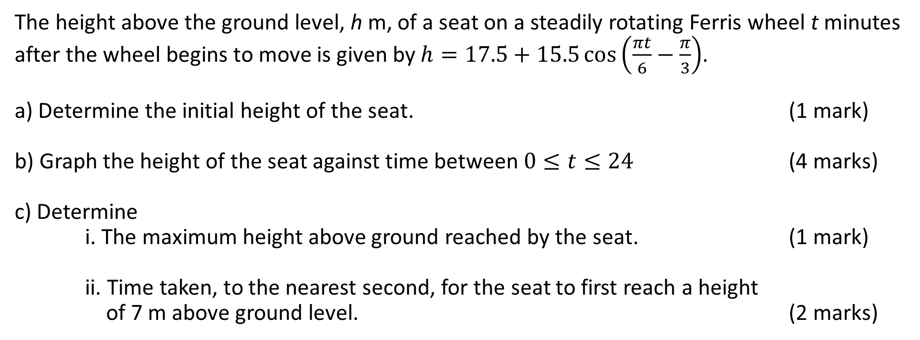
2020 CALC ASSUMED
The height above the ground level, h m, of a seat on a steadily rotating Ferris wheel t minutes after the wheel begins to move is given by $h=17.5+15.5\cos\left(\frac{πt}{6}−\frac{π}{3}\right)$.
a) Determine the initial height of the seat. (1 mark)
b) Graph the height of the seat against time between $0≤t≤24$ (4 marks)
c) Determine i. The maximum height above ground reached by the seat. (1 mark)
ii. Time taken, to the nearest second, for the seat to first reach a height of 7 m above ground level. (2 marks)

Slide 7


2020 CALC ASSUMED
The height above the ground level, h m, of a seat on a steadily rotating Ferris wheel t minutes after the wheel begins to move is given by $h=17.5+15.5\cos\left(\frac{πt}{6}−\frac{π}{3}\right)$.
a) Determine the initial height of the seat. (1 mark)
$$h\left(0\right)=25.25 m$$

Slide 8
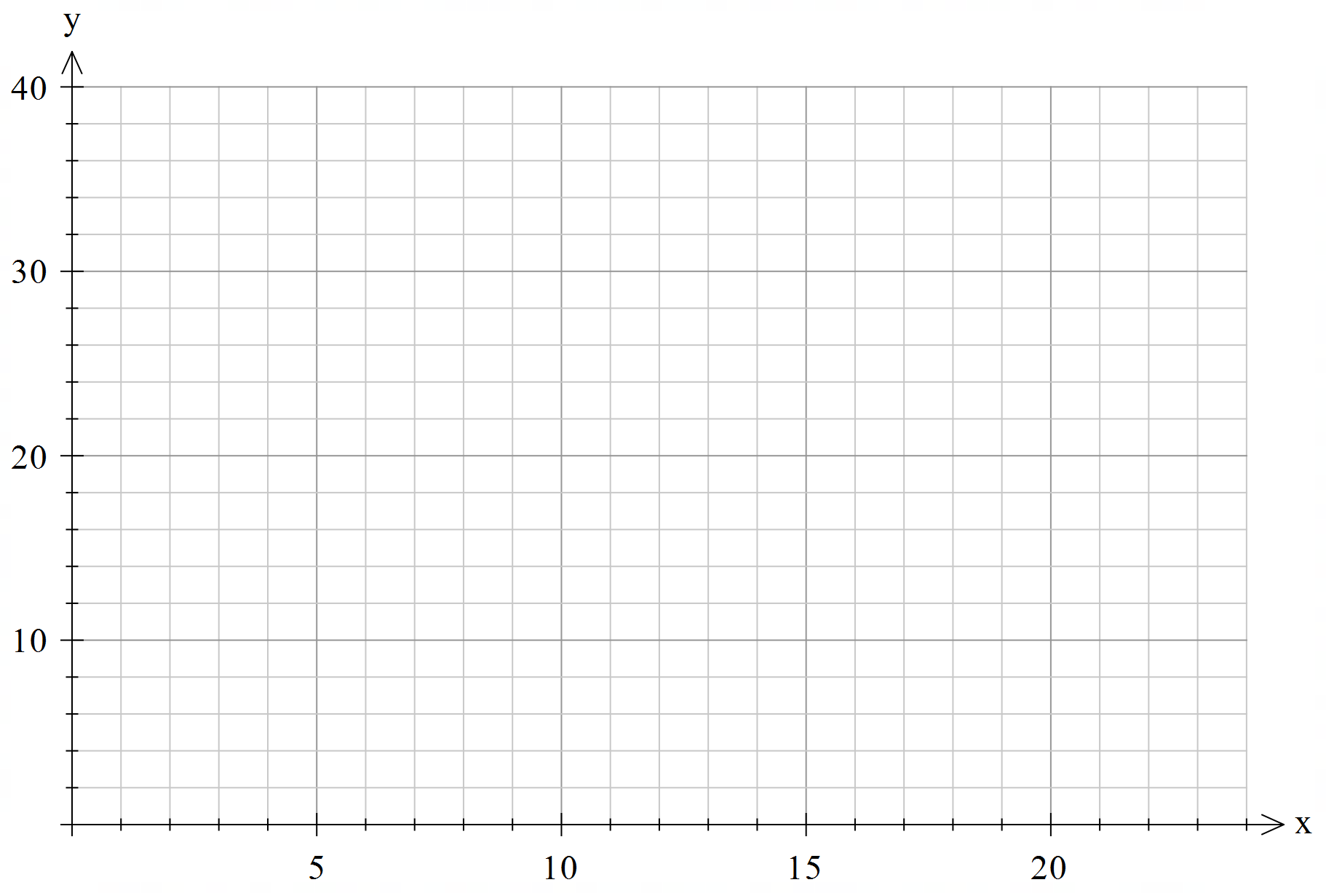
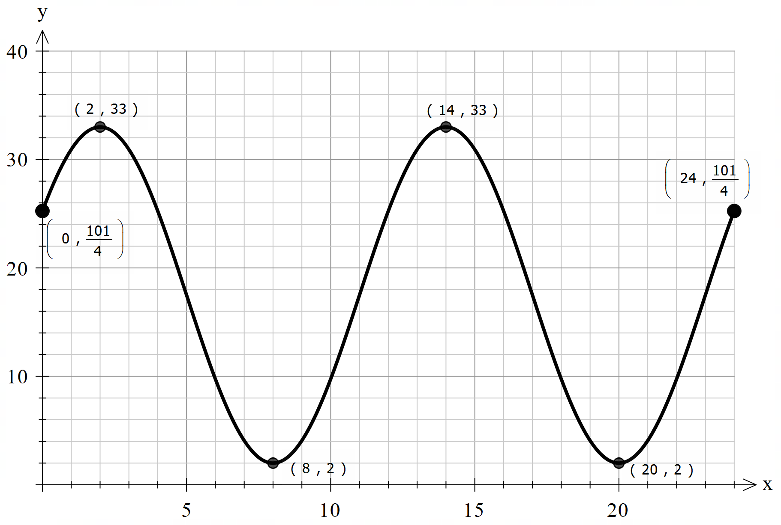
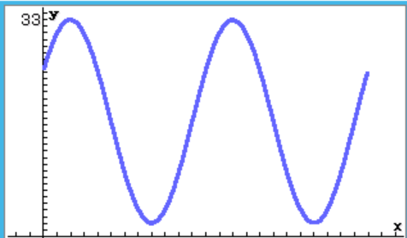
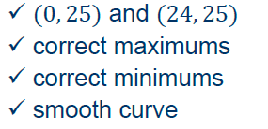

2020 CALC ASSUMED
The height above the ground level, h m, of a seat on a steadily rotating Ferris wheel t minutes after the wheel begins to move is given by $h=17.5+15.5\cos\left(\frac{πt}{6}−\frac{π}{3}\right)$.
b) Graph the height of the seat against time between $0≤t≤24$ (4 marks)

Slide 9
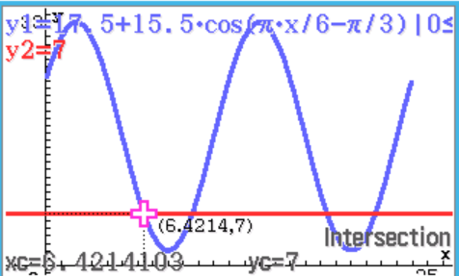

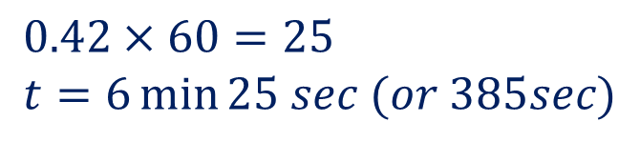
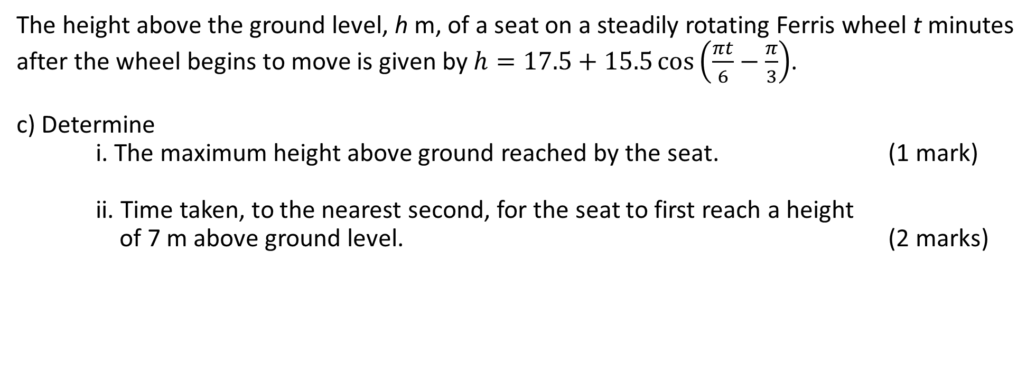

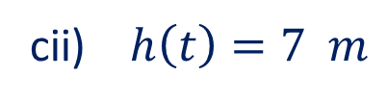

2020 CALC ASSUMED
The height above the ground level, h m, of a seat on a steadily rotating Ferris wheel t minutes after the wheel begins to move is given by $h=17.5+15.5\cos\left(\frac{πt}{6}−\frac{π}{3}\right)$.
c) Determine i. The maximum height above ground reached by the seat. (1 mark)
ii. Time taken, to the nearest second, for the seat to first reach a height of 7 m above ground level. (2 marks)
ci) $h\left(max\right)=33 m$
cii) $h\left(t\right)=7 m$
$$t=6.42 min$$
$$0.42×60=25 \\ t=6\min{25 sec (or 385sec)}$$

Slide 10
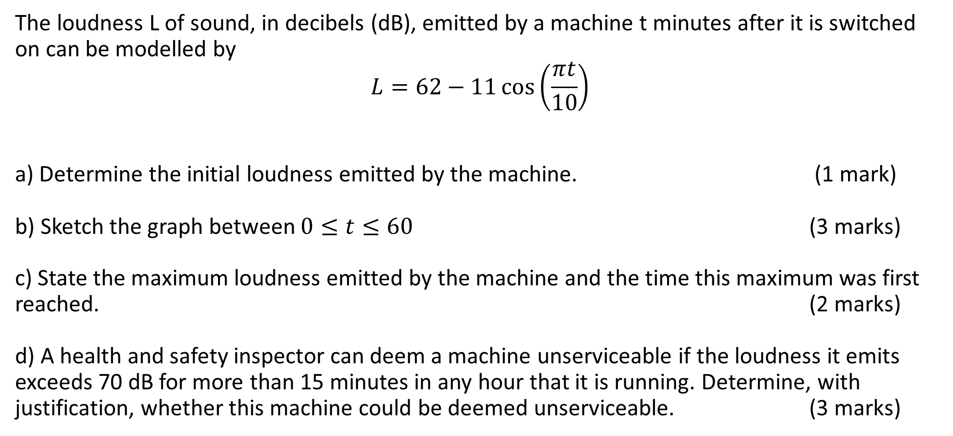
2021 CALC ASSUMED
The loudness L of sound, in decibels (dB), emitted by a machine t minutes after it is switched on can be modelled by
$$L=62−11\cos\left(\frac{πt}{10}\right)$$
a) Determine the initial loudness emitted by the machine. (1 mark)
b) Sketch the graph between $0≤t≤60$ (3 marks)
c) State the maximum loudness emitted by the machine and the time this maximum was first reached. (2 marks)
d) A health and safety inspector can deem a machine unserviceable if the loudness it emits exceeds 70 dB for more than 15 minutes in any hour that it is running. Determine, with justification, whether this machine could be deemed unserviceable. (3 marks)

Slide 11
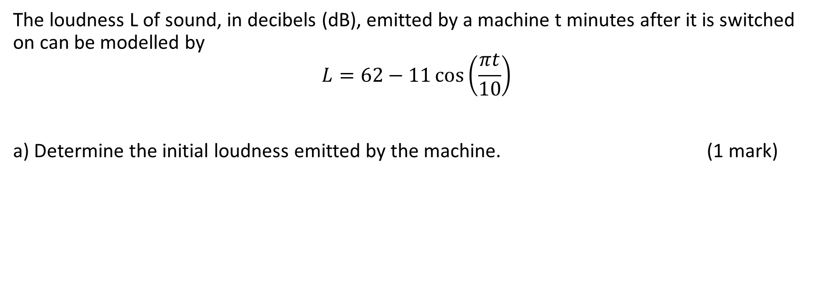

2021 CALC ASSUMED
The loudness L of sound, in decibels (dB), emitted by a machine t minutes after it is switched on can be modelled by
$$L=62−11\cos\left(\frac{πt}{10}\right)$$
a) Determine the initial loudness emitted by the machine. (1 mark)
$$L\left(0\right)=51 dB$$

Slide 12
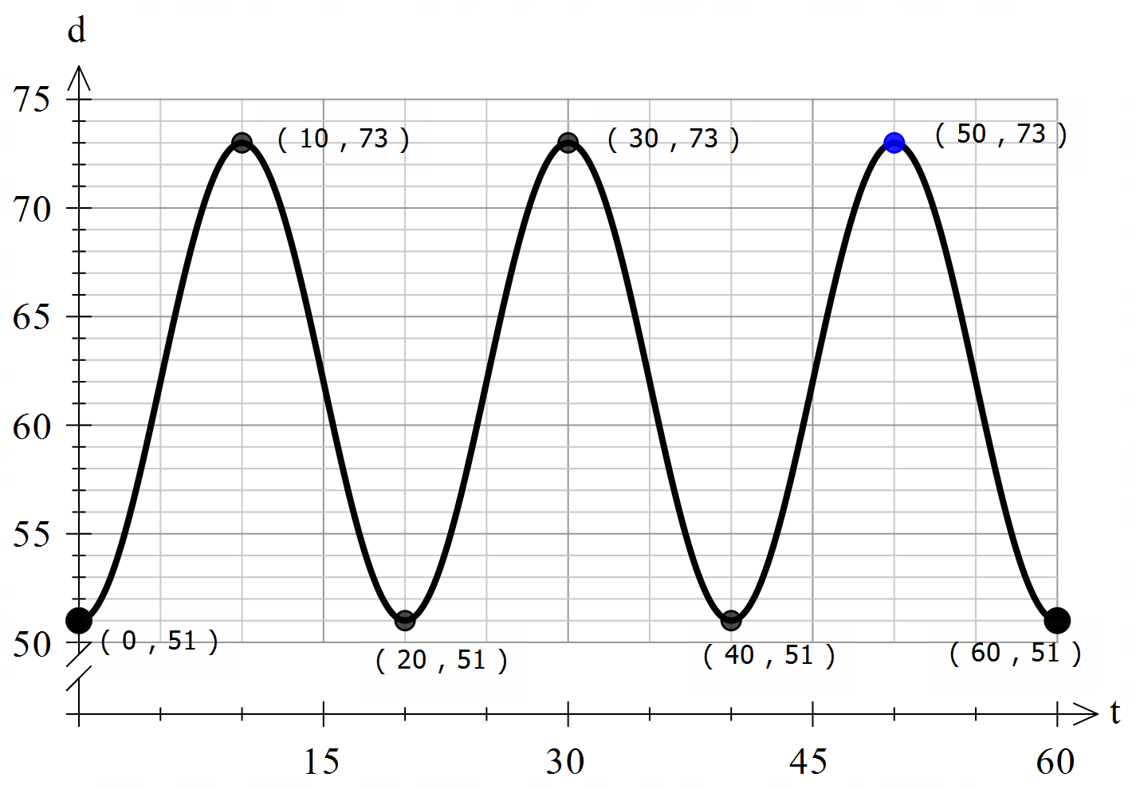
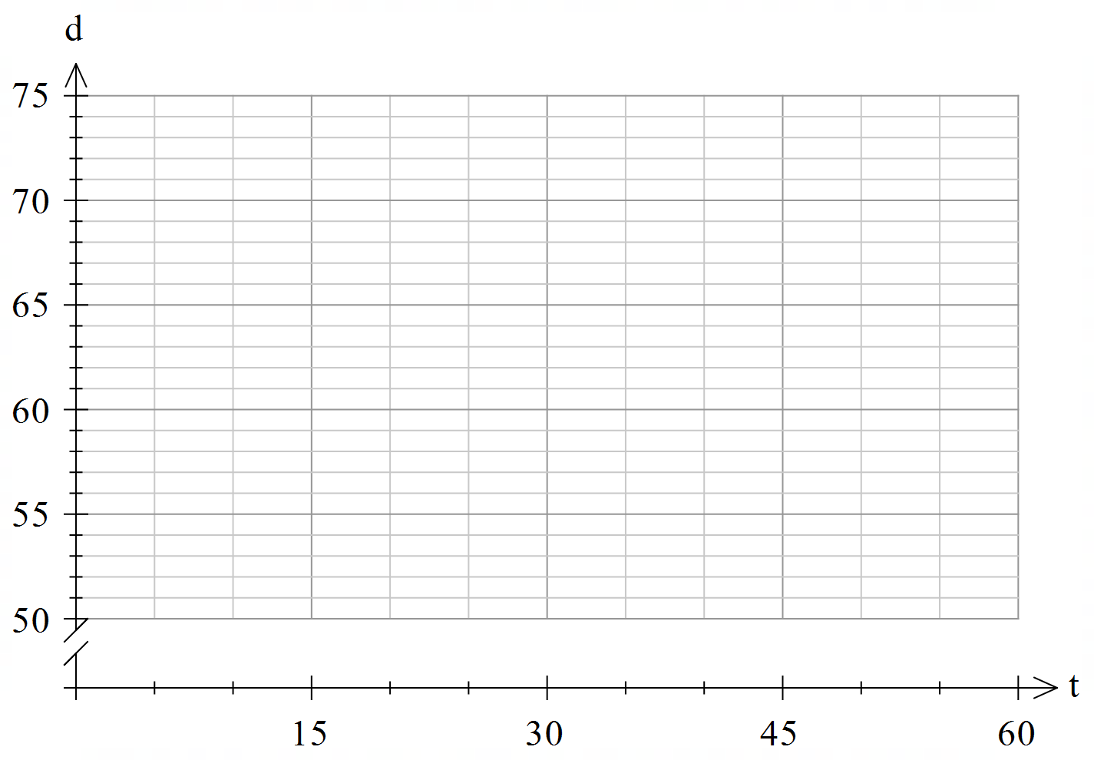
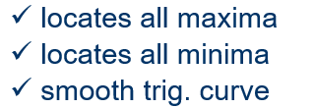

2021 CALC ASSUMED
The loudness L of sound, in decibels (dB), emitted by a machine t minutes after it is switched on can be modelled by
$$L=62−11\cos\left(\frac{πt}{10}\right)$$
b) Sketch the graph between $0≤t≤60$ (3 marks)

Slide 13

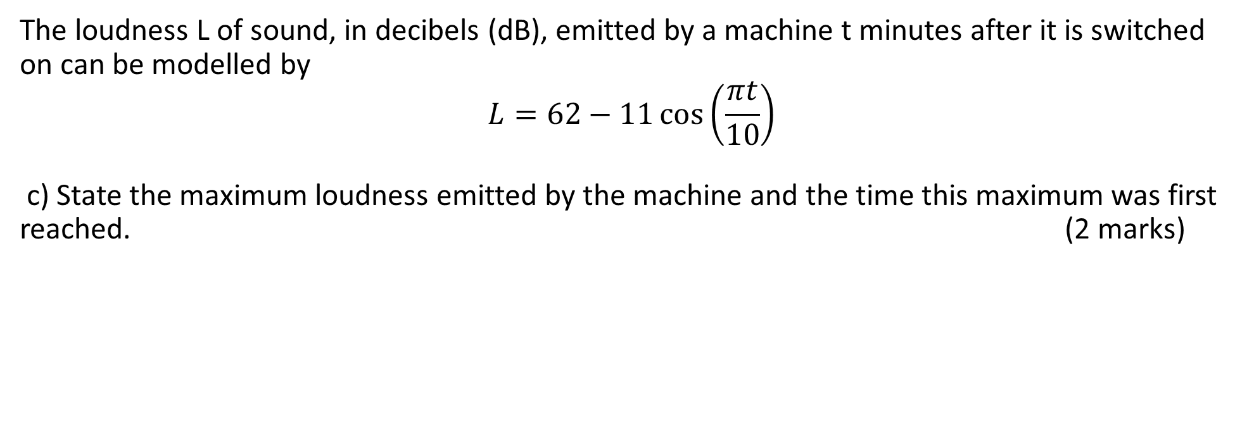

2021 CALC ASSUMED
The loudness L of sound, in decibels (dB), emitted by a machine t minutes after it is switched on can be modelled by
$$L=62−11\cos\left(\frac{πt}{10}\right)$$
c) State the maximum loudness emitted by the machine and the time this maximum was first reached. (2 marks)
$L\left(\max{ }\right)=73 dB$ when $t=10 minutes$

Slide 14
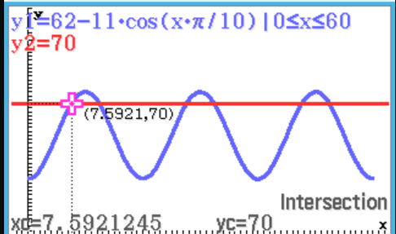
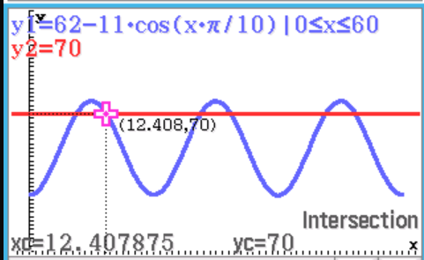




2021 CALC ASSUMED
The loudness L of sound, in decibels (dB), emitted by a machine t minutes after it is switched on can be modelled by
$$L=62−11\cos\left(\frac{πt}{10}\right)$$
d) A health and safety inspector can deem a machine unserviceable if the loudness it emits exceeds 70 dB for more than 15 minutes in any hour that it is running. Determine, with justification, whether this machine could be deemed unserviceable. (3 marks)
first cycle for when $L\left(\max{ }\right)>70dB,$
$$7.59<t<12.41$$
t$otal time=3\left(12.41 −7.59\right)$
$$=14.46\min{per hour}$$
Therefore, the machine could not be deemed unserviceable.

Slide 15
Independent Practice
Complete Cambridge Ex 12N

